Slide 1
Unit – IV
Mining Association Rules
in Large Databases

Slide 2
Mining Association Rules in Large Databases
Association rule mining finds interesting association or correlation relationships among a large set of data items
The discovery of interesting association relationships among huge amount of business transaction records can help in many business decision making process, such as catalog design, cross marketing, and loss-leader analysis.
A typical example of association rule mining is market basket analysis.
This process analyzes customers buying habits by finding associations between different items that customers place in their shopping habits.

Slide 3
Mining Association Rules in Large Databases
The discovery of such associations can help retailers develop marketing strategies by gaining insight into which items are frequently purchased together by the customers.
For instance, if customers are buying milk, how likely are they to also buy bread (and which kind of bread) on the same trip to the supermarket.
Such information can lead to increased sales by helping retailers do selective marketing and plan their shelf space.
For ex, placing milk and bread within close proximity may further encourage the sale of these items together within single visits to the store.

Slide 4
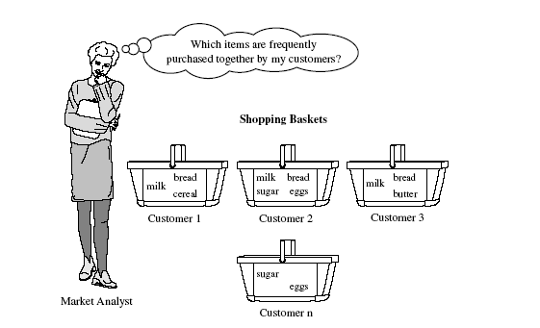

Slide 5
Market Basket Analysis
A motivating example for Association Rule Mining
Suppose, as manager of AllElectronics branch you would like to learn more about the buying habits of your customers. Specially you wonder “Which groups or sets of items are customers likely to purchase on a given trip to the store”
To answer this question, market basket analysis may be performed on the retail data of customer transactions at your store.
In one strategy items that are frequently purchased together can be placed in close proximity in order to further encourage the sale of such items together.
If customers who purchase computers also tend to buy financial management software at the same time, then placing the hardware display close to the software display may help to increase the sales of both of these items.

Slide 6
Market Basket Analysis
A motivating example for Association Rule Mining
In an alternative strategy, placing hardware and software at opposite ends of the store may entice customers who purchase such items to pick up other items along the way.
For instance, after deciding on an expensive computer, a customer may observe security systems, while heading towards management software.
If we think of the universe as the set of items available at a store, then each item has a Boolean Variable representing the presence or absence of the item.
Each basket can be represented by a Boolean Vector of values assigned to variables.
The Boolean Vectors can be analyzed for buying patterns that reflect items that are frequently associated or purchased together

Slide 7
Market Basket Analysis
A motivating example for Association Rule Mining
These patterns can be represented in the form of association rules.
For ex, the information that customers who purchase computers tend to buy financial management software at the same time is represented in the Association Rule below
computer => financial_management_software
[ support = 2%, confidence = 60%]

Slide 8
Basic Concepts
support (A=>B) = P (A Union B)
confidence (A=>B) = P(B/A) = Support(A u B)/Support(A)
How are association rules mined by from large databases?.
Association rule mining is a two step process :
Find all frequent itemsets : By definition, each of these itemsets will occur atleast as frequently as a pre-determined minimum support count
Generate strong association rules from the frequent itemsets : By definition, these rules must satisfy minimum support and minimum confidence.

Slide 9
Association Rule Mining : A Road Map
Association rules can be classified in various ways, based on the following criteria
Based on the types of values handled in the rule : If a rule concerns associations between the presence or absence of items, it is a Boolean Association Rule.
For Ex :
computer => financial_management_software
[ support = 2%, confidence = 60%]

Slide 10
Association Rule Mining : A Road Map
If a rule describes associations between quantitative items or attributes, then it is a quantitative association rule.
In these rule, quantitative values for items or attributes are partitioned into intervals. The following rule is an ex of a quantitative association rule, where X is a variable representing a customer
age (x, “30..39”) ^ income (x, “42..48K”)
→buys (x, high resolution TV)

Slide 11
Association Rule Mining : A Road Map
Based on the dimensions of data involved in the rule : If the items or attributes in an association rule reference only one dimension, then it is a single dimensional association rule.
Note that Rule
computer => financial_management_software
[ support = 2%, confidence = 60%]
can be rewritten as
buys (x, “computer”) → buys (x, “financial software”)

Slide 12
Association Rule Mining : A Road Map
Note that Rule
computer => financial_management_software
[ support = 2%, confidence = 60%]
is a single dimensional association rule since it refers to only one dimension, buys. If a rule references two or more dimensions, such as the dimensions buys, time_of_transaction, and customer_category, then it is a multidimensional association rule.
age (x, “30..39”) ^ income (x, “42..48K”)
→buys (x, high resolution TV)
The above rule is considered a multidimensional association rule since it involves three dimensions, age, income, and buys

Slide 13
Association Rule Mining : A Road Map
Based on the levels of abstractions involved in the rule set : Some methods for association rule mining can find rules at differing levels of abstraction. For ex, suppose that a set of association rules mined include the following rules.
age(x, “30..39”) →buys (x, “laptop computer”) a
age(x, “30..39”) →buys (x, “computer”) b
In rules a and b the items bought are referenced at different levels of abstraction (eg. “computer” is a higher-level abstraction of “laptop computer”
We refer to the rule set mined as consisting of multilevel association rules.

Slide 14
Types of Association Rule Mining
Boolean vs. quantitative associations
(Based on the types of values handled)
  buys(x, “computer”) → buys(x, “financial software”) [2%, 60%]
  age(x, “30..39”) ^ income(x, “42..48K”) →buys(x, “PC”) [1%, 75%]
Single dimension vs. multiple dimensional associations
  buys(x, “computer”) → buys(x, “financial software”) [2%, 60%]
  age(x, “30..39”) ^ income(x, “42..48K”) →buys(x, “PC”) [1%, 75%]

Slide 15
Types of Association Rule Mining
Single level vs. multiple-level analysis
  What brands of beers are associated with what brands of diapers?
Various extensions
  Correlation, causality analysis
    Association does not necessarily imply correlation or causality
  Constraints enforced
    E.g., small sales (sum < 100) trigger big buys (sum > 1,000)?

Slide 16
Let us consider the following set of transactions in a bookshop.
t1 := {ANN,CC,TC,CG}
t2:= {CC,D,CG}
t3 := {ANN,CC,TC,CG}
t4:= {ANN,CC,D,CG}
t5:= {ANN,CC,D,TC,CG}
t6:= {CC,D,TC}
I={ANN,CC,D,TC,CG} and T:={t1,t2,t3,t4,t5,t6}

Slide 17
Association Rule: Basic Concepts
Given:
database of transactions,
each transaction is a list of items (purchased by a customer in a visit)
Find: all rules that correlate the presence of one set of items with that of another set of items
  E.g., 98% of people who purchase tires and auto accessories also get automotive services done

Slide 18
Association Rule Definitions
Set of items: I={I₁,I₂,…,I_{m}}
Transactions: D = {t1, t2,.., tn} be a set of transactions, where a transaction,t, is a set of items
Itemset: {I_{i1},I_{i2}, …, I_{ik}} ⊆ I
Support of an itemset: Percentage of transactions which contain that itemset.
Large (Frequent) itemset: Itemset whose number of occurrences is above a threshold.

Slide 19
Rule Measures: Support & Confidence
An association rule is of the form : X → Y where X, Y are subsets of I, and X INTERSECT Y = EMPTY
Each rule has two measures of value: support, and confidence.
Support indicates the frequencies of the occurring patterns, and confidence denotes the strength of implication in the rule.
The support of the rule X → Y is support (X UNION Y) c is the CONFIDENCE of rule X → Y if c% of transactions that contain X also contain Y, which can be written as:
    support(X UNION Y)/support(X)

Slide 20
Association Discovery
Given a user specified minimum support (called MINSUP) and minimum confidence (called MINCONF), an important
PROBLEM is to find all high confidence, large itemsets (frequent sets, sets with high support). (where support and confidence are larger than minsup and minconf).
This problem can be decomposed into two subproblems:
1. Find all large itemsets: with support > minsup (frequent sets).
2. For a large itemset, X and B ∈X (or Y ⊂ X) , find those rules, X\{B} => B ( X-Y → Y) for which confidence > minconf.

Slide 21
Mining Association Rules in Large Databases
Association rule mining
Mining single-dimensional Boolean association rules from transactional databases
Mining multilevel association rules from transactional databases.

Slide 22
The Apriori Algorithm: Basics
The Apriori Algorithm is an influential algorithm for mining frequent item sets for Boolean association rules. The name of algorithm is based on the fact that algorithm uses prior knowledge of frequent itemset properties.
Key Concepts :
  Frequent Itemsets: The sets of item which has minimum support (denoted by L_{i} for i^{th}-Itemset).
  Apriori Property: Any subset of frequent itemset must be frequent.
  Join Operation: To find L_{k} , a set of candidate k-itemsets is generated by joining L_{k-1} with itself.

Slide 23
The Apriori Algorithm in a Nutshell
Find the frequent itemsets: the sets of items that have minimum support
  A subset of a frequent itemset must also be a frequent itemset
    i.e., if {AB} is a frequent itemset, both {A} and {B} should be a frequent itemset
  Iteratively find frequent itemsets with cardinality from 1 to k (k-itemset)
Use the frequent itemsets to generate association rules.

Slide 24
The Apriori Algorithm : Pseudo code
Join Step: C_{k} is generated by joining L_{k-1}with itself
Prune Step: Any (k-1)-itemset that is not frequent cannot be a subset of a frequent k-itemset
Pseudo-code:
    C_{k}: Candidate itemset of size k
    L_{k} : frequent itemset of size k
    L₁ = {frequent items};
    for (k = 1; L_{k} !=∅; k++) do begin
    C_{k+1} = candidates generated from L_{k};
    for each transaction t in database do
      increment the count of all candidates in C_{k+1} that are contained in t
    L_{k+1} = candidates in C_{k+1} with min_support
    end
    return ∪_{k} L_{k};

Slide 25
The Apriori Algorithm: Example
Consider a database, D , consisting of 9 transactions.
Suppose min. support count required is 2 (i.e. min_sup = 2/9 = 22 % )
Let minimum confidence required is 70%.
We have to first find out the frequent itemset using Apriori algorithm.
Then, Association rules will be generated using min. support & min. confidence.
TID | List of Items
T100 | I1, I2, I5
T200 | I2, I4
T300 | I2, I3
T400 | I1, I2, I4
T500 | I1, I3
T600 | I2, I3
T700 | I1, I3
T800 | I1, I2 ,I3, I5
T900 | I1, I2, I3

Slide 26
Step 1: Generating 1-itemset Frequent Pattern
Itemset | Sup.Count
{I1} | 6
{I2} | 7
{I3} | 6
{I4} | 2
{I5} | 2
Itemset | Sup.Count
{I1} | 6
{I2} | 7
{I3} | 6
{I4} | 2
{I5} | 2
Compare candidate support count with minimum support count
Scan D for count of each candidate
C₁
L₁
In the first iteration of the algorithm, each item is a member of the set of candidate.
The set of frequent 1-itemsets, L₁ , consists of the candidate 1-itemsets satisfying minimum support.

Slide 27
Step 2: Generating 2-itemset Frequent Pattern
To discover the set of frequent 2-itemsets, L2 , the algorithm uses L1 Join L1 to generate a candidate set of 2-itemsets, C2.
Next, the transactions in D are scanned and the support count for each candidate itemset in C2 is accumulated (as shown in the middle table).
The set of frequent 2-itemsets, L2 , is then determined, consisting of those candidate 2-itemsets in C2 having minimum support.
Note: We haven’t used Apriori Property yet.

Slide 28
L1 = {I1,I2,I3,I4,I5}
Since L2 = L1 join L1 then
{I1,I2,I3,I4,I5} join {I1,I2,I3,I4,I5}
It becomes
[ {I1,I2} {I1,I3}, {I1,I4}, {I1,I5}, {I2,I3}, {I2,I4}, {I2,I5}, {I3,I4} {I3,I5}, {I4,I5} ].
Now we need to check the frequent item sets with min support count
Then we get
L2= [ {I1,I2} {I1,I3}, {I1,I5}, {I2,I3}, {I2,I4}, {I2,I5} ].
Similarly We do it for L3

Slide 29
Step 2: Generating 2-itemset Frequent Pattern
Itemset
{I1, I2}
{I1, I3}
{I1, I4}
{I1, I5}
{I2, I3}
{I2, I4}
{I2, I5}
{I3, I4}
{I3, I5}
{I4, I5}
Itemset | Sup. Count
{I1, I2} | 4
{I1, I3} | 4
{I1, I4} | 1
{I1, I5} | 2
{I2, I3} | 4
{I2, I4} | 2
{I2, I5} | 2
{I3, I4} | 0
{I3, I5} | 1
{I4, I5} | 0
Itemset | Sup Count
{I1, I2} | 4
{I1, I3} | 4
{I1, I5} | 2
{I2, I3} | 4
{I2, I4} | 2
{I2, I5} | 2
Generate C₂ candidates from L₁
Compare candidate support count with minimum support count
Scan D for count of each candidate
L₂
C₂
C₂

Slide 30
Step 2: Generating 2-itemset Frequent Pattern [Cont.]
To discover the set of frequent 2-itemsets, L₂ , the algorithm uses L₁ Join L₁ to generate a candidate set of 2-itemsets, C₂.
Next, the transactions in D are scanned and the support count for each candidate itemset in C₂ is accumulated (as shown in the middle table).
The set of frequent 2-itemsets, L₂ , is then determined, consisting of those candidate 2-itemsets in C₂ having minimum support.
Note: We haven’t used Apriori Property yet.

Slide 31
Step 3: Generating 3-itemset Frequent Pattern
L2= [ {I1,I2} {I1,I3}, {I1,I5}, {I2,I3}, {I2,I4}, {I2,I5} ].
L3 = L2 JOIN L2 i.e.
Procedure Step 1 :
Find Items starting with I2 in B
It gives {I1, I2, I3}, {I1, I2, I4}, {I1, I2, I5}
Step 2 :
Find Items starting with I3 in B
It gives NIL, Similarly I4, I5
Step 3 :
Find out infrequent items sets using min support count and remove them.
A
{I1,I2}
{I1,I3},
{I1,I5},
{I2,I3},
{I2,I4},
{I2,I5}].
B
{I1,I2}
{I1,I3},
{I1,I5},
{I2,I3},
{I2,I4},
{I2,I5}].
J
O
I
N
C
{I1,I2,I3},
{I1,I2,I5}.
=>

Slide 32
Step 3: Generating 3-itemset Frequent Pattern
Compare candidate support count with min support count
Scan D for count of each candidate
Scan D for count of each candidate
Itemset | Sup. Count
{I1, I2, I3} | 2
{I1, I2, I5} | 2
Itemset | Sup Count
{I1, I2, I3} | 2
{I1, I2, I5} | 2
Itemset
{I1, I2, I3}
{I1, I2, I5}
C₃
C₃
L₃
The generation of the set of candidate 3-itemsets, C₃ , involves use of the Apriori Property.
In order to find C₃, we compute L₂ Join L₂.
C₃ = L2 Join L2 = {{I1, I2, I3}, {I1, I2, I5}, {I1, I3, I5}, {I2, I3, I4}, {I2, I3, I5}, {I2, I4, I5}}.
Now, Join step is complete and Prune step will be used to reduce the size of C₃. Prune step helps to avoid heavy computation due to large C_{k}.

Slide 33
Step 3: Generating 3-itemset Frequent Pattern [Cont.]
Based on the Apriori property that all subsets of a frequent itemset must also be frequent, we can determine that four latter candidates cannot possibly be frequent. How ?
For example , lets take {I1, I2, I3}. The 2-item subsets of it are {I1, I2}, {I1, I3} & {I2, I3}. Since all 2-item subsets of {I1, I2, I3} are members of L₂, We will keep {I1, I2, I3} in C₃.
Lets take another example of {I2, I3, I5} which shows how the pruning is performed. The 2-item subsets are {I2, I3}, {I2, I5} & {I3,I5}.
BUT, {I3, I5} is not a member of L₂ and hence it is not frequent violating Apriori Property. Thus We will have to remove {I2, I3, I5} from C₃.
Therefore, C₃ = {{I1, I2, I3}, {I1, I2, I5}} after checking for all members of result of Join operation for Pruning.
Now, the transactions in D are scanned in order to determine L₃, consisting of those candidates 3-itemsets in C₃ having minimum support.

Slide 34
Step 4: Generating 4-itemset Frequent Pattern
The algorithm uses L₃ Join L₃ to generate a candidate set of 4-itemsets, C₄. Although the join results in {{I1, I2, I3, I5}}, this itemset is pruned since its subset {{I2, I3, I5}} is not frequent.
Thus, C₄ = φ , and algorithm terminates, having found all of the frequent items. This completes our Apriori Algorithm.
What’s Next ?
These frequent itemsets will be used to generate strong association rules ( where strong association rules satisfy both minimum support & minimum confidence).

Slide 35
Step 5: Generating Association Rules from Frequent Itemsets
Procedure:
  For each frequent itemset “l”, generate all nonempty subsets of l.
  For every nonempty subset s of l, output the rule “s → (l-s)” if
  support_count(l) / support_count(s) >= min_conf where min_conf is minimum confidence threshold.
Back To Example:
We had L = {{I1}, {I2}, {I3}, {I4}, {I5}, {I1,I2}, {I1,I3}, {I1,I5}, {I2,I3}, {I2,I4}, {I2,I5}, {I1,I2,I3}, {I1,I2,I5}}.
  Lets take l = {I1,I2,I5}.
  Its all nonempty subsets are {I1,I2}, {I1,I5}, {I2,I5}, {I1}, {I2}, {I5}.

Slide 36
Step 5: Generating Association Rules from Frequent Itemsets [Cont.]
Let minimum confidence threshold is , say 70%.
The resulting association rules are shown below, each listed with its confidence.
  R1: I1 ^ I2 → I5
    Confidence = sc{I1,I2,I5}/sc{I1,I2} = 2/4 = 50%
    R1 is Rejected.
  R2: I1 ^ I5 → I2
    Confidence = sc{I1,I2,I5}/sc{I1,I5} = 2/2 = 100%
    R2 is Selected.
  R3: I2 ^ I5 → I1
    Confidence = sc{I1,I2,I5}/sc{I2,I5} = 2/2 = 100%
    R3 is Selected.
  R4: I1 → I2 ^ I5 confidence=2/6=33%
  R5: I2 → I1 ^ I5 confidence=2/7=29%
  R6: I5 → I1 ^ I2 confidence=2/2=100%

Slide 37
Step 5: Generating Association Rules from Frequent Itemsets [Cont.]
  R4: I1 → I2 ^ I5
    Confidence = sc{I1,I2,I5}/sc{I1} = 2/6 = 33%
    R4 is Rejected.
  R5: I2 → I1 ^ I5
    Confidence = sc{I1,I2,I5}/{I2} = 2/7 = 29%
    R5 is Rejected.
  R6: I5 → I1 ^ I2
    Confidence = sc{I1,I2,I5}/ {I5} = 2/2 = 100%
    R6 is Selected.
    In this way, We have found three strong association rules.

Slide 38
Methods to Improve Apriori’s Efficiency
Hash-based Technique (Hashing itemset counts) : A hash-based technique can be used to reduce the size of the candidate k-itemsets, Ck, for K>1. For ex, when scanning each transaction in the database to generate the frequent 1-itemsets, L1, from the candidate 1-itemsets in C1, we can generate all of the 2-itemsets for each transaction, hash (i.e. map) them into different buckets of a hash table structure, and increase the corresponding buckets count.
A 2-itemset whose corresponding bucket count in the hash table is below the support threshold cannot be frequent and thus should be removed from the candidate set. Such a hash-based technique may substantially reduce the number of candidates k-itemsets examined.

Slide 39
Hash-based technique
Let us assume:
Item Order
I1 - 1
I2 - 2
I3 - 3
I4 - 4
I5 - 5

Slide 40
Bucket address | 0 | 1 | 2 | 3 | 4 | 5 | 6
Bucket Count | 2 | 2 | 4 | 2 | 2 | 4 | 4
Bucket Contents | {I1,I4} {I3,I5} | {I1,I5} {I1,I5} | {I2,I3} {I2,I3} {I2,I3} {I2,I3} | {I2,I4} {I2,I4} | {I2,I5} | {I1,I2} {I1,I2} {I1,I2}{I1,I2} | {I1,I3} {I1,I3} {I1,I3} {I1,I3}
Create hash table H2 using hash function
h(x,y) = ((order of x) x 10 + (order of y )) mod 7
From table of step 2 (of two item set) first take {I1, I2}
Then apply formula like h(x,y) = ((1 ) x 10 + (2)) mod 7
This gives 5. So put this in column 5 and increase bucket count by 1
Then go the main table and find all {I1, I2) and do the same.

Slide 41
FORMULA = h(x,y) = ((order of x) x 10 + (order of )) mod 7
From table of step 2 (of two item set) first take {I1, I3}
Then apply formula like h(x,y) = ((1 ) x 10 + (3)) mod 7
This gives 6. So put this in column 6 and increase bucket count by 1
Then go the main table and find all {I1, I3) and do the same.
FORMULA = h(x,y) = ((order of x) x 10 + (order of )) mod 7
From table of step 2 (of two item set) first take {I1, I4}
Then apply formula like h(x,y) = ((1 ) x 10 + (4)) mod 7
This gives 0. So put this in column 0 and increase bucket count by 1
Then go the main table and find all {I1, I4) and do the same.
Similarly do for the rest of the combinations

Slide 42
Bucket address | 0 | 1 | 2 | 3 | 4 | 5 | 6
Bucket Count | 2 | 2 | 4 | 2 | 2 | 4 | 4
Bucket Contents | {I1,I4} {I3,I5} | {I1,I5} {I1,I5} | {I2,I3} {I2,I3} {I2,I3} {I2,I3} | {I2,I4} {I2,I4} | {I2,I5} | {I1,I2} {I1,I2} {I1,I2}{I1,I2} | {I1,I3} {I1,I3} {I1,I3} {I1,I3}
This hash table was generated by scanning the transactions of previous figure while determining L1 from C1. If the minimum support count is say 3, then the itemsets in bucket 0,1,3, and 4 cannot be frequent and so they should not be included in C2.

Slide 43
Methods to Improve Apriori’s Efficiency
Hash-based itemset counting: A k-itemset whose corresponding hashing bucket count is below the threshold cannot be frequent
Transaction reduction: A transaction that does not contain any frequent k-itemset is useless in subsequent scans
Partitioning: Any itemset that is potentially frequent in DB must be frequent in at least one of the partitions of DB
Sampling: mining on a subset of given data, lower support threshold + a method to determine the completeness
Dynamic itemset counting: add new candidate itemsets only when all of their subsets are estimated to be frequent

Slide 44
Is Apriori Fast Enough? — Performance Bottlenecks
The core of the Apriori algorithm:
  Use frequent (k – 1)-itemsets to generate candidate frequent k-itemsets
  Use database scan and pattern matching to collect counts for the candidate itemsets
The bottleneck of Apriori: candidate generation
  Huge candidate sets:
    10⁴ frequent 1-itemset will generate 10⁷ candidate 2-itemsets
    To discover a frequent pattern of size 100, e.g., {a₁, a₂, …, a₁₀₀}, one needs to generate 2¹⁰⁰ ≈ 10³⁰ candidates.
  Multiple scans of database:
    Needs (n +1 ) scans, n is the length of the longest pattern

Slide 45
Mining Frequent Patterns Without Candidate Generation
Compress a large database into a compact, Frequent-Pattern tree (FP-tree) structure
  highly condensed, but complete for frequent pattern mining
  avoid costly database scans
Develop an efficient, FP-tree-based frequent pattern mining method
  A divide-and-conquer methodology: decompose mining tasks into smaller ones
  Avoid candidate generation: sub-database test only!

Slide 46
Example :
We reexamine the mining of transaction database D.
The first scan of the database is the same as
Apriori, which derives the set of frequent items (1-itemsets) and their support counts (frequencies).
Let the minimum support count be 2.
The set of frequent items is stored in the order of descending support count.
This resulting set or list is denoted as L.
Thus, we have L = [ I2:7, I1:6, I3:6, I4:2, I5:2],

Slide 47
An FP-tree is then constructed as follows:
First, create the root of the tree, labeled with “null”.
Scan database D a second time. The items in each transaction are processed in L order (i.e. sorted according to descending support count) and a branch is created for each transaction.
For ex, the scan of the first transaction, “T100 : I1,I2,I5 which contains three items (I2,I1,I5) in L order leads to the construction of the first branch of the tree with three nodes : (I2:1),(I1:1),(I5:1), where I2 is linked as a child of the root, I1 is linked to I2, and I5 is linked to I2
In second transaction T200, contains the items I2 and I4 in L order, which would result in a branch were I2 is linked to the root and I4 is linked to I2.
However this branch would share a common prefix, (I2), with the existing path for T100. Therefore we instead increment the count of the I2 node by 1, and create a new node (I4:1), which is linked as a child of (I2:2).
In general, when considering the branch to be added for a transaction, the count of each node among a common prefix is incremented by 1, and nodes for the items following the prefix and created and linked accordingly

Slide 48
Steps:
1 Scan DB once, find frequent 1-itemset (single item pattern)
2 Order frequent items in frequency descending order
3 Scan DB again, construct FP-tree
“T100” : I1,I2,I5 -> (I2,I1,I5) in L order
“T200” : I2,I4 -> I2,I4 in L order
“T300” : I2,I3 -> I2,I3 in L order
“T400” : I1,I2,I4 -> I2,I1,I4 in L order
“T500” : I1,I3 -> I1,I3 in L order
“T600” : I2,I3 -> I2,I3 in L order
“T700” : I1,I3 -> I1,I3 in L order
“T800” : I1,I2,I3,I5 -> I2,I1,I3,I5 in L order
“T900” : I1,I2,I3 -> I2,I1,I3 in L order

Slide 49
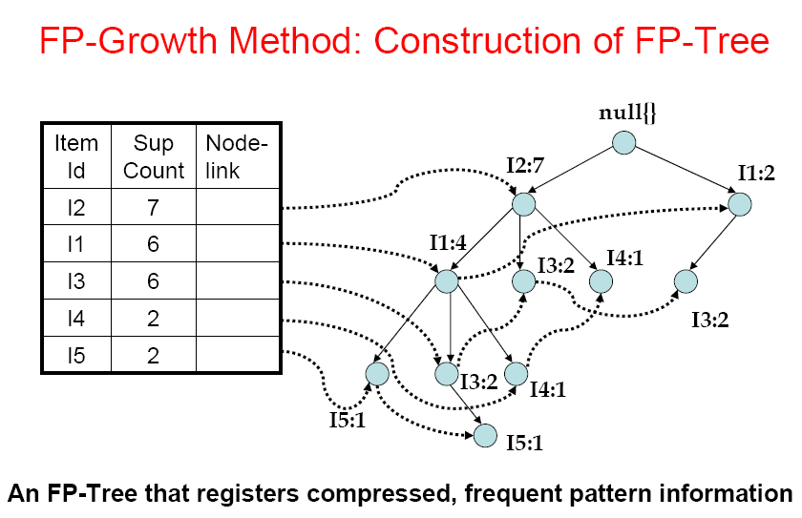

Slide 50
Benefits of the FP-tree Structure
Completeness:
  never breaks a long pattern of any transaction
  preserves complete information for frequent pattern mining
Compactness
  reduce irrelevant information—infrequent items are gone
  frequency descending ordering: more frequent items are more likely to be shared
  never be larger than the original database (if not count node-links and counts)
  Example: For Connect-4 DB, compression ratio could be over 100

Slide 51
Mining Frequent Patterns Using FP-tree
General idea (divide-and-conquer)
  Recursively grow frequent pattern path using the FP-tree
Method
  For each item, construct its conditional pattern-base, and then its conditional FP-tree
  Repeat the process on each newly created conditional FP-tree
  Until the resulting FP-tree is empty, or it contains only one path (single path will generate all the combinations of its sub-paths, each of which is a frequent pattern)

Slide 52
Major Steps to Mine FP-tree
Mining of he FP-Tree is summarized in the table below.
Let us consider I5 which is the last item in L1, rather than the first.
The reasoning behind this will become apparent as we explain the FP- Tree process.
I5 occurs in two branches of the FP-Tree (Back 3 slides)
The occurrences of I5 can easily be found by following its chain of node-links.
The paths formed by these branches are <(I2 I1 I5 : 1)> and <(I2 I1 I3 I5 : 1)>
Therefore considering I5 as a suffix, its corresponding two prefix paths are <(I2 I1 : 1)) and <(I2 I1 I3 :1)>, which from its conditional pattern base.
Its conditional FP-Tree contains only a single path, <I2:2, I1:2) ; I3 is not included because its support count of 1 is less than the minimum support count.
The single path generates all the combinations of frequent patterns : I2 I5:2,I1 I5:2, I2 I1 I5:2

Slide 53
Item | Conditional pattern base | Conditional FP-Tree | Frequent patterns generated
I5 | {(I2 I1:1), (I2 I1 I3:1)} | <I2:2, I1:2> | I2 I5:2, I1 I5:2, I2 I1 I5:2
I4 | {(I2 I1:1), (I2:1)} | <I2:2> | I2 I4:2
I3 | {(I2 I1:2), (I2:2), (I1:2)} | <I2:4, I1:2>, <I1:2> | I2 I3:4, I1, I3:2, I2 I1 I3 :2
I1 | {(I2 :4)} | <I2:4> | I2 I1:4
For I4, its two prefix paths from the conditional pattern base, {(I2 I1 : 1), (I2 :1)} which generates a single node conditional FP-tree <I2:2> and derives one frequent pattern I2 I4 :2.
Similarly I3’s conditional pattern base is : {(I2 I1 :2), (I2:2), (I1:2)}.
Its conditional FP-tree has two branches <I2:4, I1:2> AND <I1:2>, as shown in the figure below, which generates the set of patterns {I2 I3 :4, I1 I3:2, I2 I1 I3:2}
Finally I1’s conditional pattern base is {(I2:4)}, whose FP-tree contains only one node <I2:4>, which generates one frequent pattern I2 I1 : 4.

Slide 54
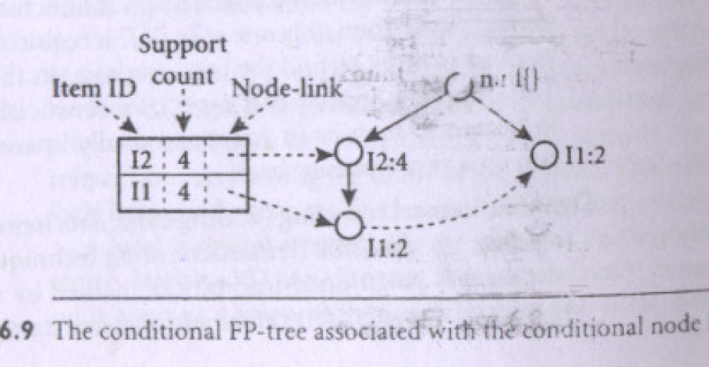

Slide 55
Major Steps to Mine FP-tree
Construct conditional pattern base for each node in the FP-tree
Construct conditional FP-tree from each conditional pattern-base
Recursively mine conditional FP-trees and grow frequent patterns obtained so far
  If the conditional FP-tree contains a single path, simply enumerate all the patterns

Slide 56
Why Is Frequent Pattern Growth Fast?
Our performance study shows
  FP-growth is an order of magnitude faster than Apriori, and is also faster than tree-projection
Reasoning
  No candidate generation, no candidate test
  Use compact data structure
  Eliminate repeated database scan
  Basic operation is counting and FP-tree building

Slide 57
Iceberg Queries
The Aprioiri algorithm can be used to improve the efficiency of answering iceberg queries.
Icerberg query: Compute aggregates over one or a set of attributes only for those whose aggregate values is above certain threshold
Example:
    select P.custID, P.itemID, sum(P.qty)
    from purchase P
    group by P.custID, P.itemID
    having sum(P.qty) >= 10
Compute iceberg queries efficiently by Apriori:
  First compute lower dimensions
  Then compute higher dimensions only when all the lower ones are above the threshold

Slide 58
Example
A database has five transactions. Let min sup = 60% and min con f = 80%.
TID items bought
T100 M, O, N, K, E, Y
T200 D, O, N, K, E, Y
T300 M, A, K, E
T400 M, U, C, K, Y
T500 C, O, O, K, I, E
(a) Find all frequent itemsets using Apriori and FP-growth, respectively.
compare the efficiency of the two mining processes.
(b) List all of the strong association rules (with support s and confidence c) matching the following metarule, where X is a variable representing customers, and item i denotes variables representing items (e.g., “A”, “B”, etc.):
For every x belongs to transaction, buys(X, item1)^buys(X, item2))buys(X, item3) [s, c]

Slide 59
Mining Association Rules in Large Databases
Association rule mining
Mining single-dimensional Boolean association rules from transactional databases
Mining multilevel association rules from transactional databases

Slide 60
Multiple-Level Association Rules
For many applications, it is difficult to find strong associations among data items at low or primitive levels of abstractions due to sparsity of data in multidimensional space.
Therefore, data mining systems should provide capabilities to mine association rules at multiple levels of abstraction and traverse easily among different abstraction space
Lets examine the following example
Suppose we are given the task relevant set of transactional data in Table (next slide) for sales at the computer department of an AllElectronics Branch.
The concept hierarchy for the items is shown in next slide
The concept hierarchy has four levels referred as levels 0,1,2,3.

Slide 61
TID | Items Purchased
T1 | IBM desktop computer, Sony B/W printer
T2 | Microsoft educational software, Microsoft Financial Software
T3 | Logitech Mouse, Computer Accessory, Ergoway Wrist Pad
T4 | IBM desktop computer, Microsoft Financial Software
T5 | IBM desktop computer
.

Slide 62
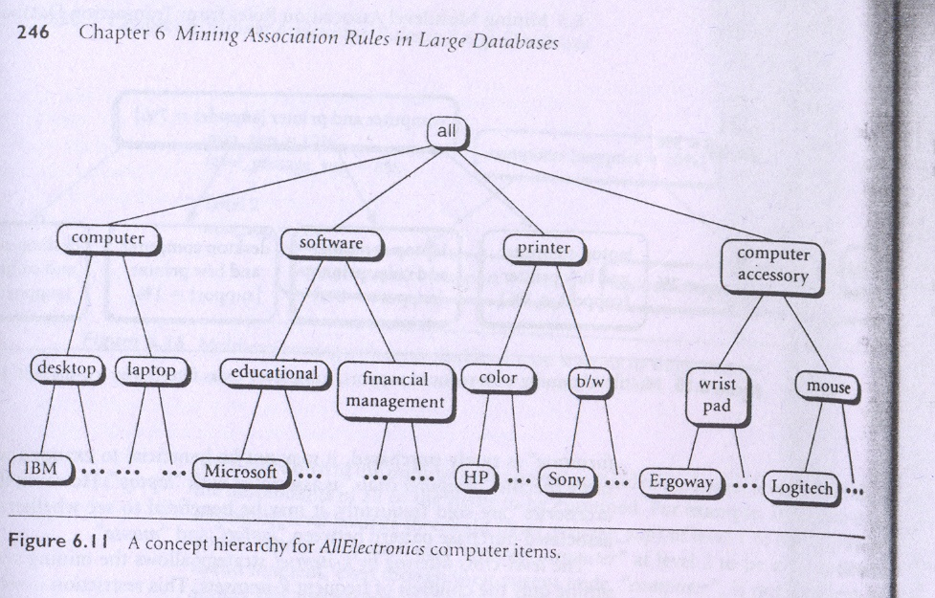

Slide 63
By convention, levels within a concept hierarchy are numbered from top to bottom, starting with level 0 at the root node for all (the most general abstract level).
Here level 1 includes computer, software, printer, and computer accessory
Level 2 includes desktop computer, laptop computer, educational software, financial software etc.
Level 3 includes IBM desktop computer, Microsoft software etc.
Level 3 represents the most specific abstraction level of this hierarchy
The items in Table are the lowest level of the concept hierarchy of Figure. It is difficult to find interesting purchase patterns at such raw or primitive level data.

Slide 64
One would expect that it is easier to find strong association between “IBM desktop computer” and “B/W printer” rather than between “IBM desktop computer” and “Sony B/W printer
Similarly, many people may purchase “computer” and “printer” together, rather than specifically purchasing “IBM desktop computer” and “Sony b/w printer” together.
In other words, itemsets containing generalized items, such as “{IBM desktop computer, b/w printer}” replaced by {computer, printer} are easier to find interesting associations.
Rules generated from association rule mining with concept hierarchies are called multi-level association rules.

Slide 65
Mining Multi-Level Associations
A top down, progressive deepening approach is used :
  First find high-level strong rules:
milk ® bread [20%, 60%].
  Then find their lower-level “weaker” rules:
milk ® wheat bread [6%, 50%].

Slide 66
Multi-level Association: Uniform Support vs. Reduced Support
Uniform Support: the same minimum support for all levels
  + One minimum support threshold. No need to examine itemsets containing any item whose ancestors do not have minimum support.
  – Lower level items do not occur as frequently. If support threshold
    too high ⇒ miss low level associations
    too low ⇒ generate too many high level associations

Slide 67
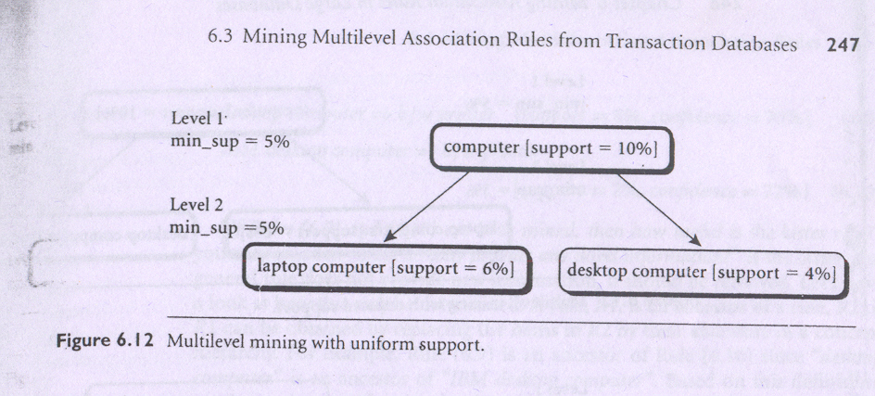

Slide 68
Multi-level Association: Uniform Support vs. Reduced Support
Reduced Support: reduced minimum support at lower levels
  There are 4 search strategies:
    Level-by-level independent
    Level-cross filtering by k-itemset
    Level-cross filtering by single item
    Controlled level-cross filtering by single item

Slide 69
Level-by-level independent : This is a full breadth search. Each node is examined, regardless of whether or not its parent node is found to be frequent
Level-cross filtering by single item : If a node is frequent, its children will be examined; otherwise, its descendent nodes are pruned from the search. For ex computer i.e. laptop and desktop are not examined since computer is not frequent
Level-cross filtering by k-itemset : The 2 itemset “{computer, printer}” is frequent, therefore the other nodes are examined
Controlled level-cross filtering by single item : A modified version of the level cross filtering by single item strategy. A threshold, called the level passage threshold can be set up for passing down relatively frequent item (called subfrequent items) to lower levels.

Slide 70
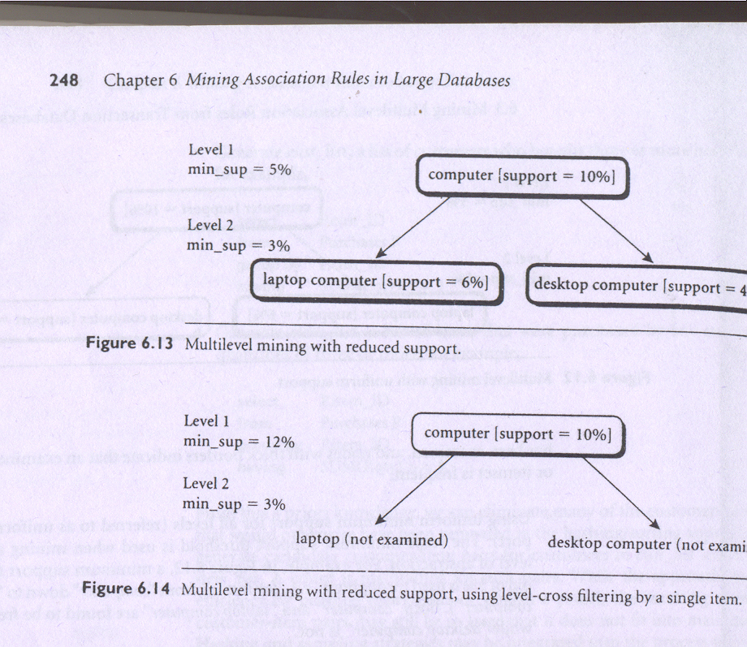

Slide 71
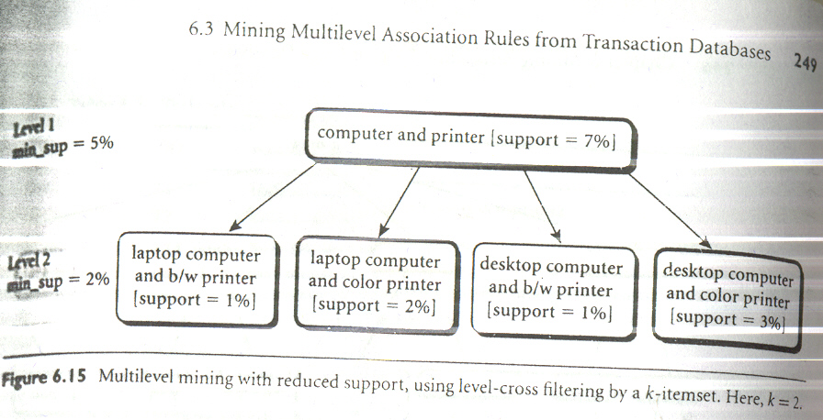

Slide 72
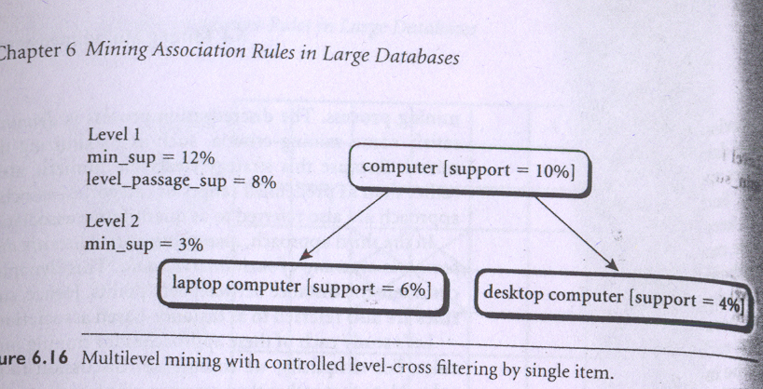

Slide 73
Multi-level Association: Redundancy Filtering
Some rules may be redundant due to “ancestor” relationships between items.
Example
  Desktop computer ⇒ b/w printer [support = 8%, confidence = 70%]
  IBM desktop computer ⇒ b/w printer [support = 2%, confidence = 72%]
We say the first rule is an ancestor of the second rule.
A rule is redundant if its support is close to the “expected” value, based on the rule’s ancestor.

Slide 74
END

